Slide 1
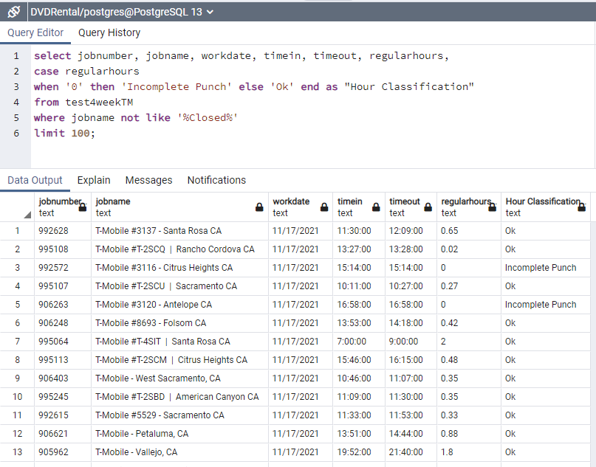
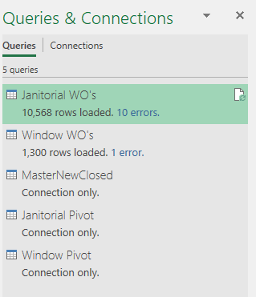
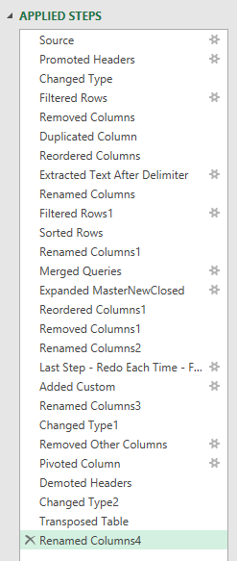
Database Management - SQL
Transformations (Automation or BI)

Slide 2
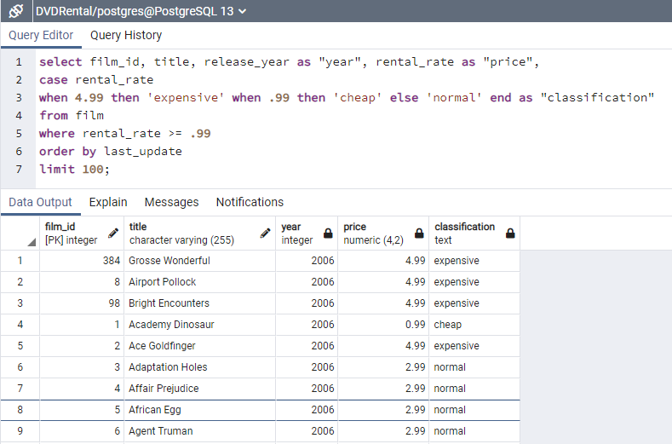
CASE: SINGLE COLUMN
When renaming column, still use old column name in query. It hasn’t officially been renamed yet until data output.
Case is specific, where can have range
select film_id, title, release_year as "year", rental_rate as "price",
case rental_rate
when 4.99 then 'expensive' when .99 then 'cheap' else 'normal' end as "classification"
from film
where rental_rate >= .99
order by last_update
limit 100;

Slide 3
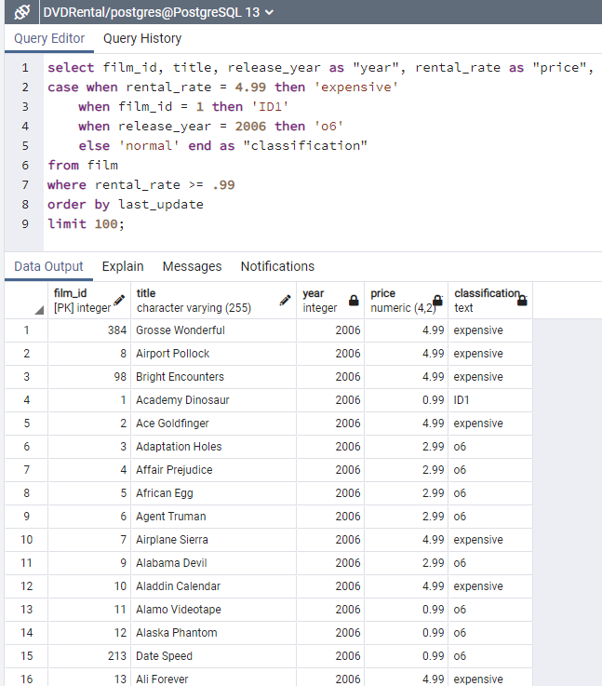
CASE: MULTIPLE COLUMNS
If multiple conditions are met, the first listed condition takes precedence.” – pg 241
Add when column_name =
To each clause.
The single column you just list all out (previous slide)
This one you list out each columns and = is needed!
Remember if there are multiple conditions that over lap, they go in order!!!
Look at line 4: ‘ID1’ clause came before year 2006 clause ‘o6’ in the statements.
Therefore is returned the first hit, ‘ID1’
select film_id, title, release_year as "year", rental_rate as "price",
case rental_rate
when 4.99 then 'expensive' when .99 then 'cheap' else 'normal' end as "classification"
from film
where rental_rate >= .99
order by last_update
limit 100;

Slide 4
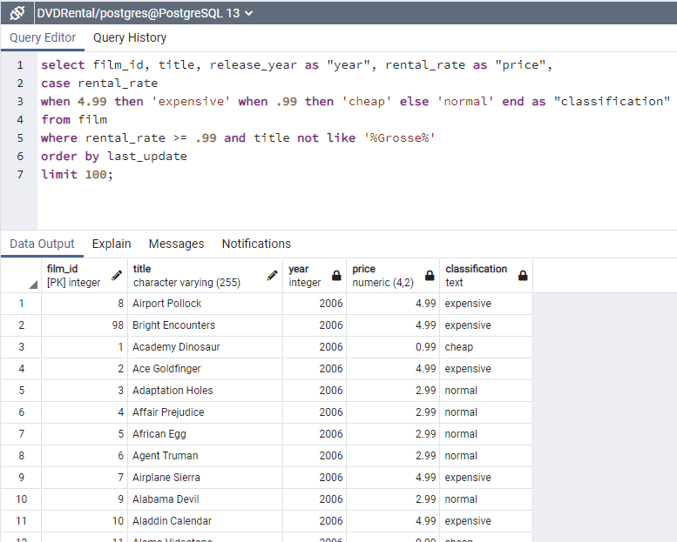
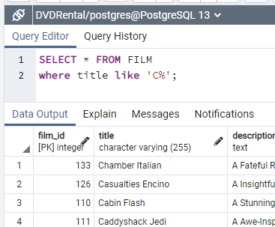
NOT LIKE in WHERE statement: where [column name] not like ‘%this%’
All titles that start with C are end with anything.
% is anything before/after
_ is any 1 character
Removed anything with the contents “Grosse” which was a movie (Grosse Wonderful, film_id 384).
Can use this to remove classifications, outliers, etc. from the data output.
select film_id, title, release_year as "year", rental_rate as "price",
case rental_rate
when 4.99 then 'expensive' when .99 then 'cheap' else 'normal' end as "classification"
from film
where rental_rate >= .99 and title not like '%Grosse%'
order by last_update
limit 100;

Slide 5
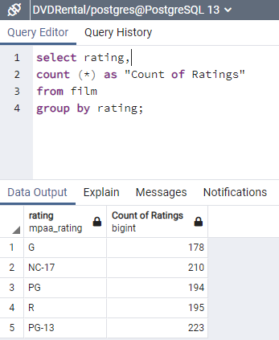
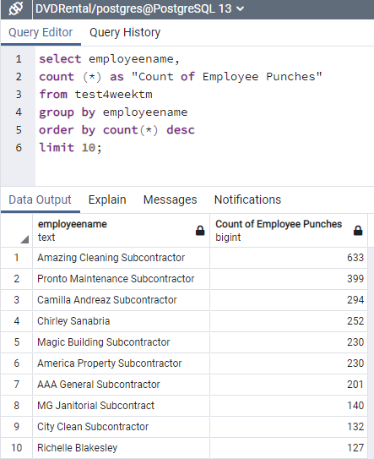
COUNT (showing count of ratings)
Since we say “GROUP BY rating”
We are telling SQL to put all ratings into each individual group (vs many rows)
Order By sorting largest to smallest
select rating,
count (*) as "Count of Ratings"
from film
group by rating;
select employeename,
count (*) as "Count of Employee Punches"
from test4weektm
group by employeename
order by count(*) desc
limit 10;

Slide 6
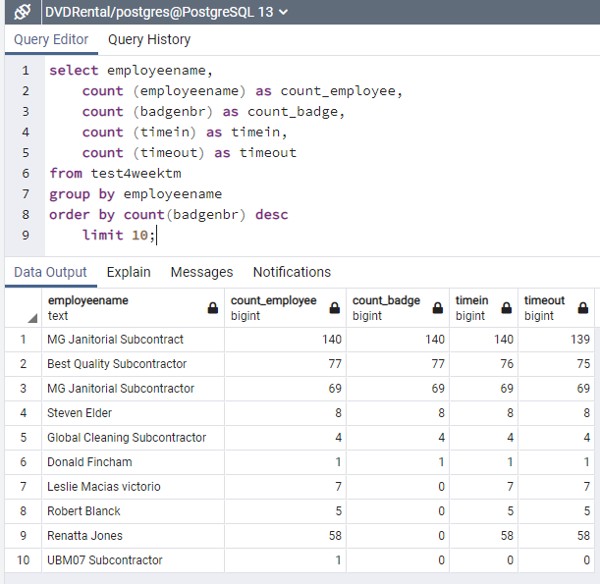
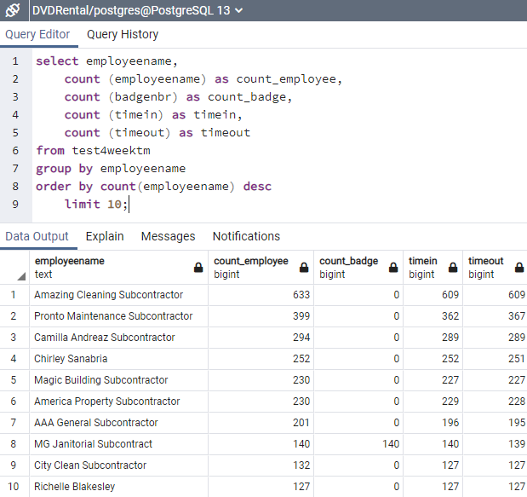
COUNT – Multiple Counts (think crosstabulation)
Multiple counts (need as renaming to label columns)
Order By & Limit go together here!!! (both are optional)
Basically, the limit 10 is applied to the Count_Badge because that’s how we sorted.
If we changed the Order By to employeename, it would have a different selection of 10.
select employeename,
count (employeename) as count_employee,
count (badgenbr) as count_badge,
count (timein) as timein,
count (timeout) as timeout
from test4weektm
group by employeename
order by count(badgenbr) desc
limit 10;
select employeename,
count (employeename) as count_employee,
count (badgenbr) as count_badge,
count (timein) as timein,
count (timeout) as timeout
from test4weektm
group by employeename
order by count(employeename) desc
limit 10;

Slide 7
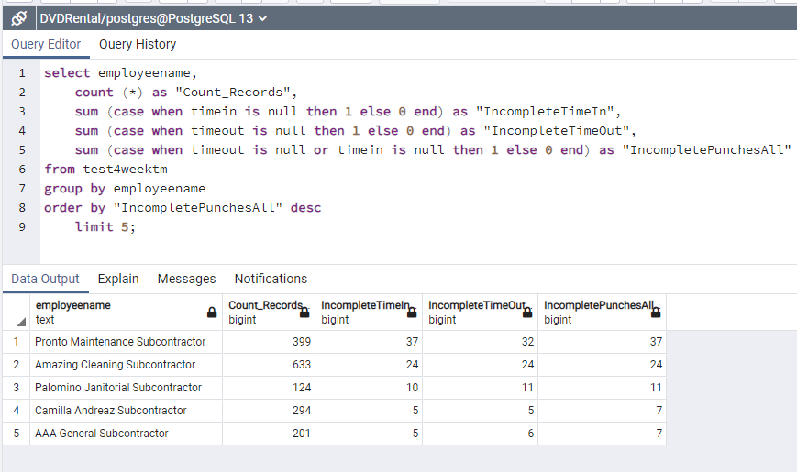
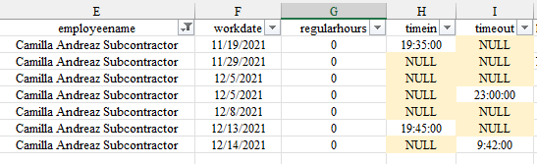
Count/Sum + Case (Aggregation + Case Statement)
Can add OR statement to CASE to get multiple criteria.
Here we combined missed In + Missed Out.
Can add CASE statements to aggregated data!
If renaming columsn with hard quotes, must use hard quotes on bottom too (this is to keep capitalization if desired)
Remember, Limit goes with Order By.
The 5 limited is from the top 5 Incomplete punches column (most).
select employeename,
count (*) as "Count_Records",
sum (case when timein is null then 1 else 0 end) as "IncompleteTimeIn",
sum (case when timeout is null then 1 else 0 end) as "IncompleteTimeOut",
sum (case when timeout is null or timein is null then 1 else 0 end) as "IncompletePunchesAll"
from test4weektm
group by employeename
order by "IncompletePunchesAll" desc
limit 5;
Line 4: We can see there were 5 incomplete timeIN and 5 incomplete timeout, but 7 IncompletePunchesAll.
So clearly there is a mix.

Slide 8
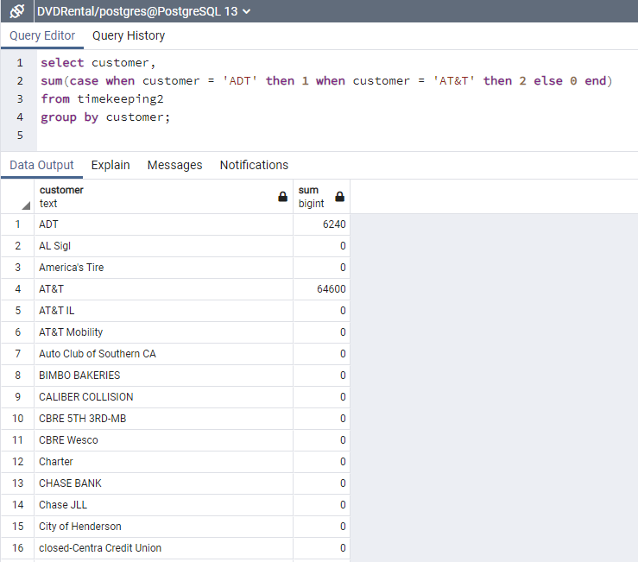
Count/Sum + Case (Aggregation + Case Statement) – PART II
Can add OR statement to CASE to get multiple criteria.
Here we combined missed In + Missed Out.
Can add CASE statements to aggregated data!
If renaming columns with hard quotes, must use hard quotes on bottom too (this is to keep capitalization if desired)
Remember, Limit goes with Order By.
The 5 limited is from the top 5 Incomplete punches column (most).
select customer,
sum(case when customer = 'ADT' then 1 when customer = 'AT&T' then 2 else 0 end)
from timekeeping2
group by customer;

Slide 9
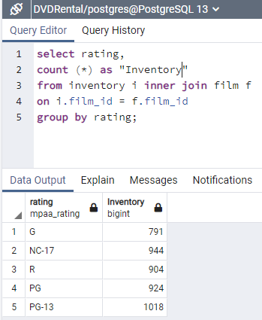
GROUP BY: COUNT (showing total inventory by rating using INNER JOIN)
Basically, did an xlookup to pull ratings data into inventory data.
=xlookup(film_id inventory, film_id film, rating)
There are 1000 distinct film_ids
But there are 4581 units in inventory.
In order for INNER JOIN to work, need to name/reference where the column names are coming from.
f = film, I = inventory.
select rating,
count (*) as "Inventory"
from inventory i inner join film f
on i.film_id = f.film_id
group by rating;

Slide 10
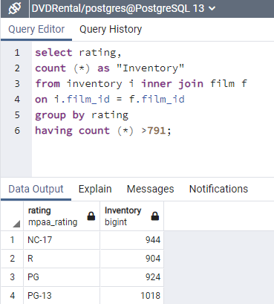
HAVING: COUNT (filters data after GROUP BY – think pivot filter)
WHERE = filter columns
HAVING = filter aggregated data
You MUST have Group By in order to use Having clause.
This is because having is done after the group by feature which aggregates the data.
Since having count > 791, it removed the previous G-rating category from the output.
Must be an operator!
Here we have count (*)
select rating,
count (*) as "Inventory"
from inventory i inner join film f
on i.film_id = f.film_id
group by rating
having count (*) >791;

Slide 11
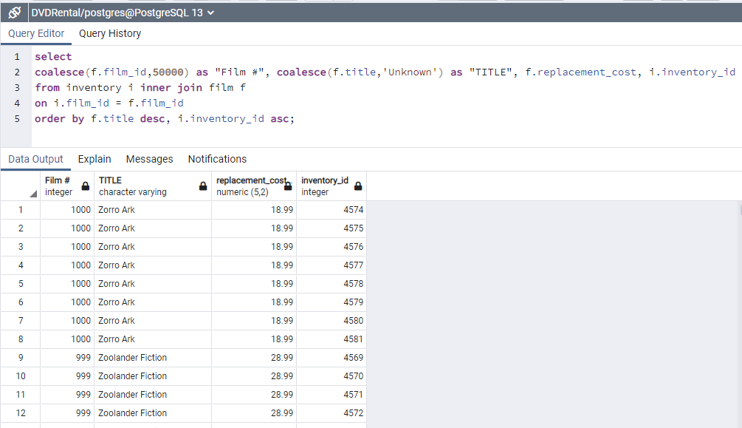
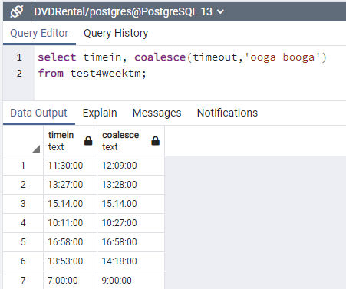
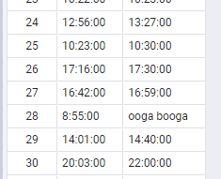
ORDER BY (sort results) + COALESCE: (replace null values with something or potentially lose data)
Coalesce is a way to replace null values with something.
Replacement must match data type in column! (text to text, numeric to numeric)
In this example, we have no null values, so Coalesce isn’t needed, but it’s good to know!
Double sorting here!
Sort title descending
Sort inventory_id ascending
select coalesce(f.film_id,50000) as "Film #", coalesce(f.title,'Unknown') as "TITLE", f.replacement_cost, i.inventory_id
from inventory i inner join film f
on i.film_id = f.film_id
order by f.title desc, i.inventory_id asc;
select timein, coalesce(timeout,'ooga booga')
from test4weektm;

Slide 12
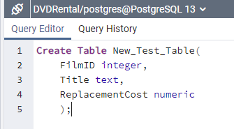
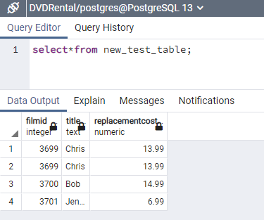
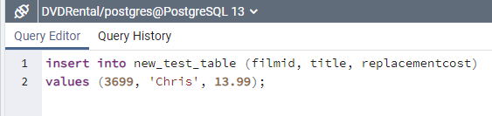
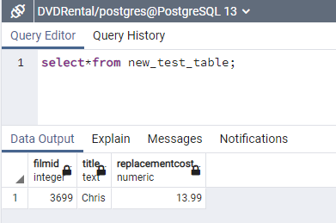
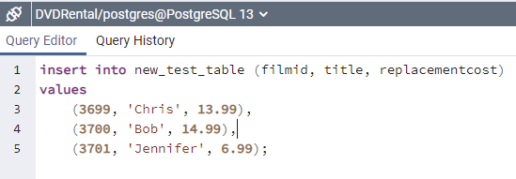
Create Table – Insert Data into Table
Create Table New_Test_Table(
FilmID integer,
Title text,
ReplacementCost numeric
);
insert into new_test_table (filmid, title, replacementcost)
values (3699, 'Chris', 13.99);
select*from new_test_table;
Order matters! Data entered must match the order of column names exactly.
insert into new_test_table (filmid, title, replacementcost)
values
(3699, 'Chris', 13.99),
(3700, 'Bob', 14.99),
(3701, 'Jennifer', 6.99);
1
2
3
1
2
3
select*from new_test_table;

Slide 13
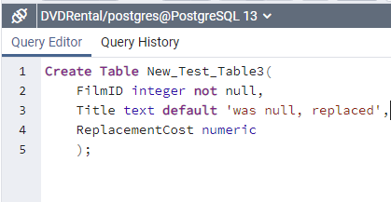
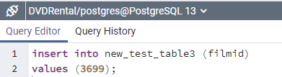
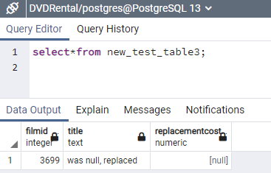
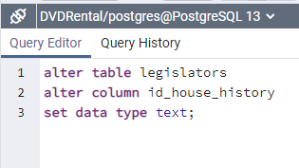
CONSTRAINTS: Not Null & Default – Add/Delete Constraints to created Table
Not Null, Default, Check, Unique
Primary Key, Foreign Key read pages 105-109 in SQL Pocket Guide
Chose a default, so since I only inserted Film_ID 3699 into table, the title became “was null, replaced” automatically.
The other no entry, replacementcost shows null.
Create Table New_Test_Table3(
FilmID integer not null,
Title text default 'was null, replaced',
ReplacementCost numeric
);
CHANGE COLUMN DATA TYPE
insert into new_test_table3 (filmid)
values (3699);
select*from new_test_table3;
alter table legislators
alter column id_house_history
set data type text;

Slide 14
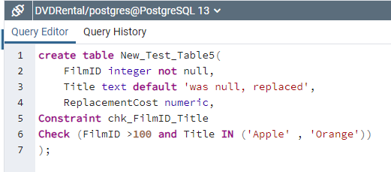
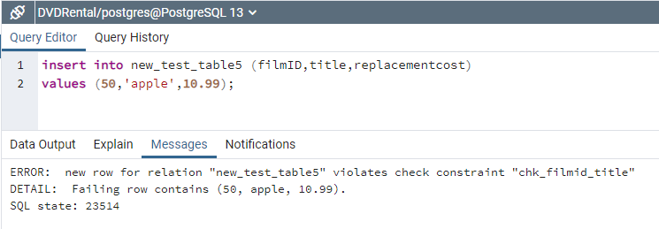
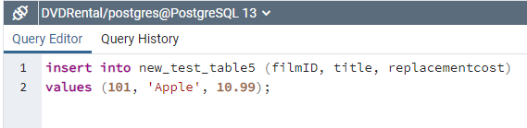
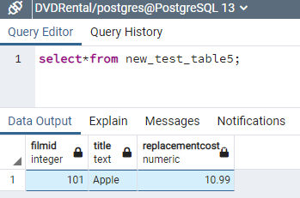
CONSTRAINTS: Check – Limit what can be entered as data to a column
Created constraint CHECK that limits the values that can be entered into FilmID & Title.
FilmID must be greater than 100
And
Title can only be “Apple” or “Orange”
create table New_Test_Table5(
FilmID integer not null,
Title text default 'was null, replaced',
ReplacementCost numeric,
Constraint chk_FilmID_Title
Check (FilmID >100 and Title IN ('Apple' , 'Orange'))
);
ERROR! FilmID was not greater than 100.
insert into new_test_table5 (filmID, title, replacementcost)
values (101, 'Apple', 10.99);
NO ERROR! 😀
select*from new_test_table5;

Slide 15
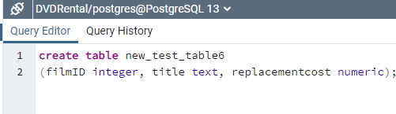
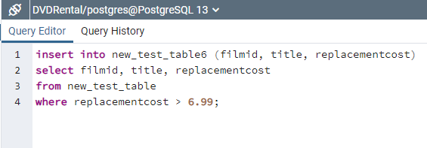
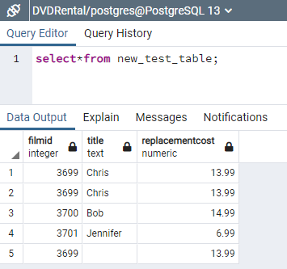
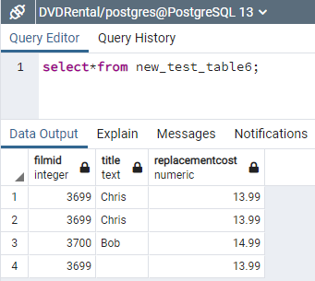
Create New Table by Inserting Data from Existing Table
Creating a new table based off data in existing tables.
Can choose columns to include or not.
Can add specifics like WHERE to limit what’s pulled in.
Better than manually entering data (of course).
create table new_test_table6
(filmID integer, title text, replacementcost numeric);
insert into new_test_table5 (filmid, title, replacementcost)
select filmid, title, replacementcost
from new_test_table
where replacementcost > 6.99;
select*from new_test_table;
select*from new_test_table6;

Slide 16
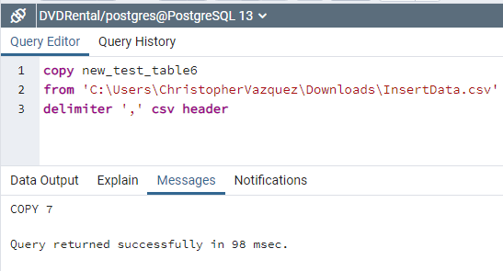
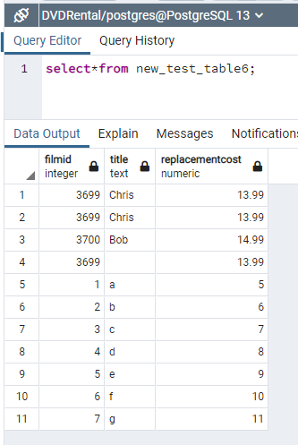
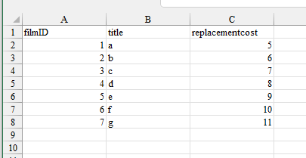
Inserting Data from .CSV (text) file [Part I]
All that is to be done is: Go to Properties of that particular file by right clicking on it. Then, go to Security tab of the displayed Properties dialog box. Click on Edit option. Permissions dialog box appears, then click on Add button. Type 'Everyone' (without apostrophes) in the "Enter the object names to select" description box and click on OK button. Then, make sure all the checkboxes of "Permissions for Everyone" are selected by just ticking the "Full Control" check box to allow the control access without any restriction. Then, Apply and OK all the tabs to apply all the changes done.
You can now run/execute the query without any errors.
Can also try a different drive besides C drive to prevent this. Here is link where I found solution:
sql - I am trying to copy a file, but getting error message - Stack Overflow
create table new_test_table6
(filmID integer, title text, replacementcost numeric);
copy new_test_table6
from 'C:\Users\ChristopherVazquez\Downloads\InsertData.csv'
delimiter ',' csv header
select*from new_test_table6;

Slide 17
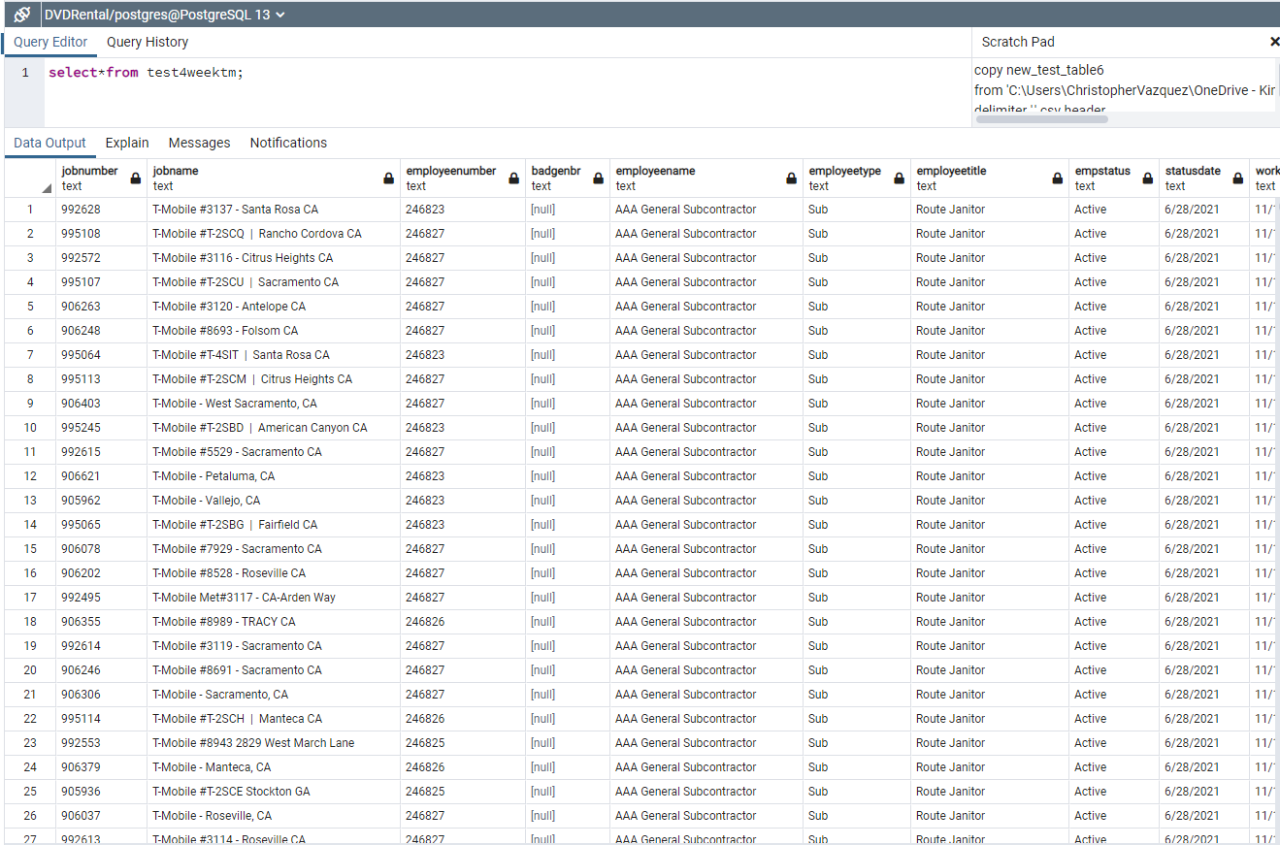
Inserting Data from .CSV (text) file [Part II, 4-Week Report]
create table Test4WeekTM
(JobNumber text, JobName text, EmployeeNumber text, BadgeNbr text, EmployeeName text, Employeetype text, EmployeeTitle text, EmpStatus text, StatusDate text, WorkDate text, HoursType text, RegularHours text, TimeIn text, TimeOut text, Lunch text, OTHours text, DTHours text, WorkTicketNumber text, JobCity text, JobState text, Customer text, RVP text, DM text, AM text, EmployeeSupervisor text, SubContractor text, CustomerLevel1 text, CustomerLevel2 text, CustomerLevel3 text, CustomerLocationID text, Week_ending text
);
copy Test4WeekTM
from 'C:\Users\ChristopherVazquez\OneDrive - Kimco Facility Services\Desktop\T-Mobile 4 Week Report.csv'
delimiter ',' csv header
select*from test4weektm;

Slide 18
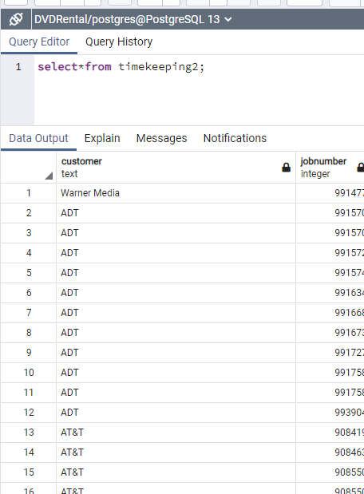
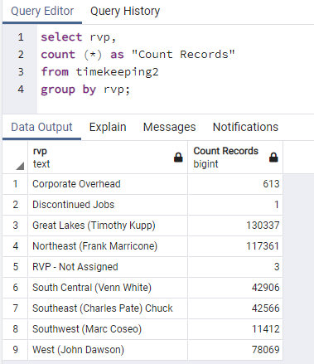
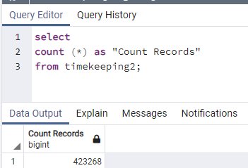
Inserting Data from .CSV (text) file [Part 3, 2 Month Data]
create table Timekeeping2
(Customer text, JobNumber int, JobDescription text, RVP text, DM text, AM text, EmployeeName text, EmployeeNumber int, EmployeeTitle text, JobState text, JobCity text, WorkDate date, TimeIn time, TimeOut time, HoursType text, RegularHours decimal
);
copy timekeeping2
from 'C:\Users\ChristopherVazquez\Downloads\Timekeeping2month.csv'
delimiter ',' csv header
select*from timekeeping2;

Slide 19
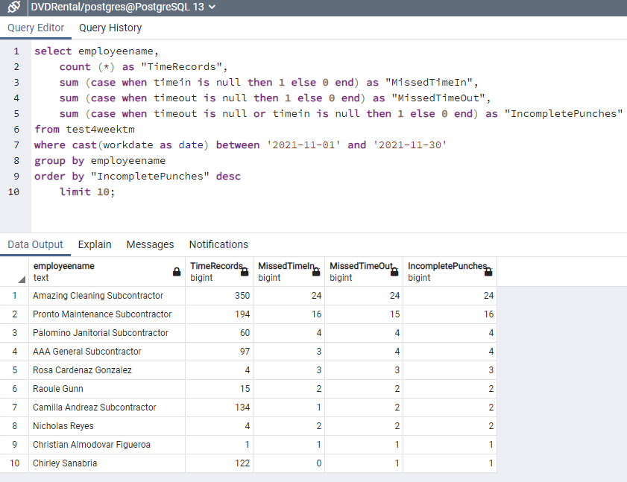
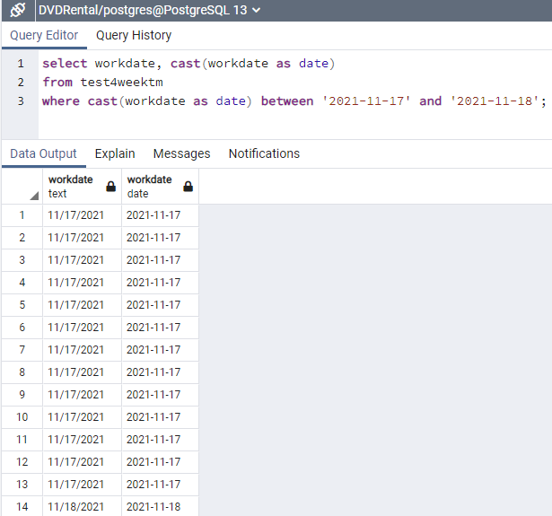
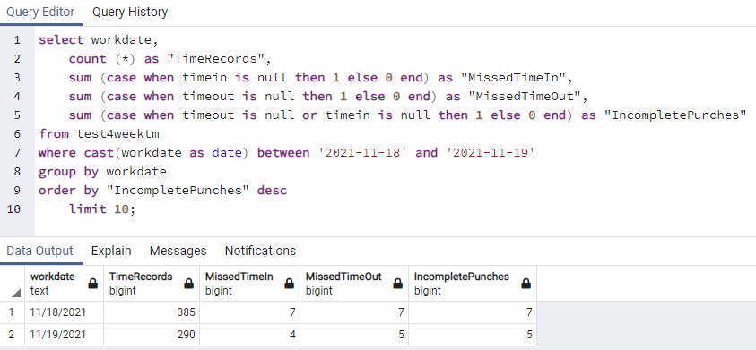
CAST – Filter Date Range – Convert String Text to Date
Cast(date_column as date) converts string text to date value.
Then to get range, use between ‘yyyy-mm-dd’ and ‘yyyy-mm-dd’
select employeename,
count (*) as "TimeRecords",
sum (case when timein is null then 1 else 0 end) as "MissedTimeIn",
sum (case when timeout is null then 1 else 0 end) as "MissedTimeOut",
sum (case when timeout is null or timein is null then 1 else 0 end) as "IncompletePunches"
from test4weektm
where cast(workdate as date) between '2021-11-01' and '2021-11-30'
group by employeename
order by "IncompletePunches" desc
limit 10;
Cast(workdate as date) is date value yyyy-mm-dd
workdate is text
select workdate, cast(workdate as date)
from test4weektm
where cast(workdate as date) between '2021-11-17' and '2021-11-18';
select workdate,
count (*) as "TimeRecords",
sum (case when timein is null then 1 else 0 end) as "MissedTimeIn",
sum (case when timeout is null then 1 else 0 end) as "MissedTimeOut",
sum (case when timeout is null or timein is null then 1 else 0 end) as "IncompletePunches"
from test4weektm
where cast(workdate as date) between '2021-11-18' and '2021-11-19'
group by workdate
order by "IncompletePunches" desc
limit 10;

Slide 20
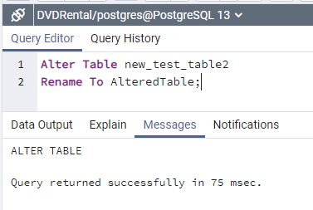
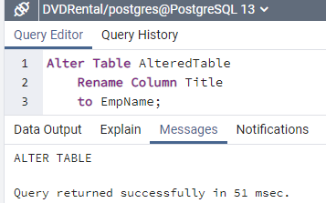
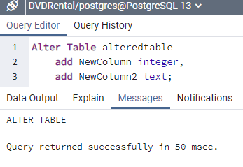
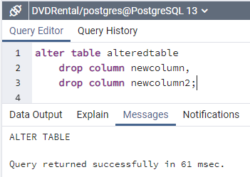




Rename Table / Rename Column/ Add Column / Drop Column
Alter Table new_test_table2
Rename To AlteredTable;
Alter Table AlteredTable
Rename Column Title
to EmpName;
Alter Table alteredtable
add NewColumn integer,
add NewColumn2 text;
alter table alteredtable
drop column newcolumn,
drop column newcolumn2;
select*from AlteredTable;
select*from AlteredTable;
select*from alteredtable;
select*from alteredtable;

Slide 21









Add Rows / Delete Rows / Add Constraint / Modify Constraint / Drop Constraint
alter table alteredtable
alter empname type Varchar(30);
alter table alteredtable
drop constraint chk_newcolumn;
delete from alteredtable
where empname = 'Bob';
alter table alteredtable
add NewColumn text;
insert into alteredtable
values ('Jake', 2.00);
select*from AlteredTable;
alter table alteredtable
add constraint chk_NewColumn
check (newcolumn = null);
select*from AlteredTable;

Slide 22


INDEXES (to speed searches up - good to have on large data)
Suppose you had 10 millions records and ran a query:
Select*from table2
Where workdate = ‘2021-01-01’
It would search every single record (all 10 million).
Create Indexes on important columns that you will query a lot: Job#, WorkDate, CustomerName, State, Etc.
But don’t create on too many columns! It takes space and when rows are added or removed the index needs to be rebuilt (takes time).
Create Index WorkDateIndex
On test4weektm (workdate)';
drop index workdateindex;

Slide 23



CREATE VIEW (to query later vs writing whole code)
Create View Top10PunchIssuesDated
as
select employeename,
count (*) as "TimeRecords",
sum (case when timein is null then 1 else 0 end) as "MissedTimeIn",
sum (case when timeout is null then 1 else 0 end) as "MissedTimeOut",
sum (case when timeout is null or timein is null then 1 else 0 end) as "IncompletePunches"
from test4weektm
where cast(workdate as date) between '2021-11-01' and '2021-11-30'
group by employeename
order by "IncompletePunches" desc
limit 10;
Let’s say this is code that I will likely run many times again and again (standard).
Writing it each time is a pain, but… we can create a simple view to reference.
select*from top10punchissuesdated;

Slide 24






Start Transaction – Begin; [run code, preview, test] then either Commit; or Rollback;
1.) Start Transaction: Begin;
2.) Create code, run, and preview using select*from to see results
3.) Rollback; or Commit;
Rollback will end transaction and not enter any code ran.
Commit; will put it into effect.
All or nothing. Either all pieces are updated or none (good).
Begin;
select*from new_test_table;
select*from new_test_table;
insert into new_test_table
values (14, 'begin2', 14.44);
commit;
rollback;
14, ‘begin2’, 14.44 saved and updated
No changes made (aborted)

Slide 25



OPERATORS – (Logical, Comparison Symbols, Comparison Words, Math)
AND, OR, IS NOT
=, <>, <, >, <=, >=
BETWEEN, EXISTS, IN, IS, NOT, NULL, LIKE
Use parentheses to dictate order of operations!
Select * From employees
Where start_date IS NOT Null
AND ( title = ‘analyst’ OR par_rate <= 25);
Unlike Excel, the operators are listed in order of speaking, rather than nested (stacked) in the front-end of formula)
+, -, *, /, %
BETWEEN is a combination or <= and >= (essentially the same thing vs having to list both and nest with OR)
Can do BETWEEN & NOT BETWEEN
Select*From test
where age NOT BETWEEN 35 and 44;
IN tests for a list of values.
Can do IN & NOT IN (careful)
Select*From employees
where e.age IN (25, 35, 45, 55);
Careful with NOT IN!!! If there is even a single null value in the search list, then no results will be returned. Use NOT EXISTS
Can use math operators with query
Select annualpay / 52 AS weeklypay
From payroll;
% = Wildcard. Good for searching match/no match in text.
Think: If(IsNumber(Search(
EXISTS is a way to compare 2 lists and works like a JOIN.
Can do EXISTS & NOT EXISTS
Join brings values from both tables, Exists brings values form a single table that match another table cross-referencing.
Query returns results of customers w/ no complaints:
Select c.id, c.name
From customerlist c
Where NOT EXISTS (Select*From ordercomplaints o
Where o.email = c.email);
IS Null & IS NOT Null
Select*From test
Where managername IS null;
Select*From test
Where managername IS NOT null;
Dividing an integer by an integer results in an integer!
Select 15 / 2; (output 7)
So, add a decimal to get a decimal
(or cast)
Select 15 / 2.0; (output 7.5)
LIKE or NOT LIKE to match a pattern % is to match one or more characters, _ is to match exactly 1 character.
WILDCARDS
‘%you%’ – text contains word you
‘you%’ – text starts with you
Select*From test
Where managername LIKE ‘%Bob%’;
Rounded to 3 decimal places here!
DO NOT do 15/2, 3 (will still result in integer with .000 at end.

Slide 26




Random #’s , Min/Max vs Least/Greatest, Rounding, Aggregate, Cast
Random()
CEIL, FLOOR, ROUND, TRUNC
Count ( ), Sum( ), Avg( )
Can use Random() function to pull a sample from a list.
Select * From test
Order By RANDOM()
Limit 20;
Celling rounds up to nearest integer
Floor rounds down to nearest integer
Select Ceiling (98.775); (output 99)
Select Floor (98.775); (output 98)
To show both aggregate and nonaggregate columns (see below), you need to select the column, then the aggregate function, then Group By.
Round will round to number of places.
Select Round(98.775 , 2); (output 98.78)
Min( ) and Max( )
Finds smallest and largest values withing a column
Trunc will cutoff at number of places.
Select Trunc (98.775 , 2); (output 98.77)
Least( ) and Greatest ( )
CAST (something AS data type)
Finds smallest and largest values withing a row
Cast is used to convert data types.
Often to convert text/string values to numeric.
If one value is null, it returns null!
See page 193

Slide 27
Length, Upper/Lower, Trim, Trim character, Ltrim/Rtrim, Concat, Position, Extract, Replace, Similar To
Length( )
Trim( )
Search and Position
Replace
Select Length(name) * From test;
Select * From test
Where Length(name) < 10;
Trim automatically removes excess spaces by default.
Select Trim(SAP) as trimmedSAP
From test;
Does text appear in a string?
Select* from test
Where textcolumn Like ‘%apple%’;
Replace text in a string.
Replace(string, old string, new string)
Data: “Here is some text.”
Select Replace(textcolumn, ‘some ‘, ‘’)
as replacedtext From test;
Output: “Here is text.”
Data: “Add some punctuation to quote.”
Select Replace(textcolumn, ‘some‘, ‘the’) as replacedtext From test;
Output: “Add the punctuation to quote.”
Upper( ) and Lower( )
What position is the text located in the string?
This gives you the # of characters until the value is found in string (starting at 1 for 1st character).
Select Position(‘%apple%’ IN textcolumn)
AS textlocation From test;
Trim(‘x’ From table)
Select Upper(name) * From test;
Select * From test
Where Lower(name) = ‘bob’;
You can remove specific characters besides excess spaces.
Select Trim(‘TMO-’ From SAP) as SAPonly
From test;
Concat( )
Concatenate will join columns and/or values together (can get creative here)
Select Concat(jobnumber, ‘ ‘, city, ‘ ‘, state)
AS jobdetails From test;
Trim(Leading ‘x’ From test)
Extract
Can designate Leading or Trailing Trims of characters (choosing leading will ignore trailing character, for example.
Extract a section of string.
Substring(string, start position, length)
Data: “Here is some text.”
Data: “Add some punctuation to quote.”
Select Substring(textcolumn, 14, 8)
as extractedtext From test;
Output: “text.”
Output: “tuation!”
Similar To
Search for #’s in string
Can use to search a variety of things (case sensitive!!!)
Select*from test
Where title Similar To ‘(Chicago|CHI|Chi|Chitown|chicago)’;
Returns results with any of those case sensitive instances found.
For instance, pull all movie names that have #’s somewhere in the title (e.g., 21 Jump Street)
Select*from test
Where title LIKE ‘%[0-9]%’;
Research more about Regular Experessions in SQL. There are ~ searches that have more options, like searching any string that contains numbers, etc.

Slide 28





DATE / TIME (some code changes depending on SQL server i.e., AGE vs DATEDIFF)
Select current_date;
Select current_time;
Select current_timestamp;
Create table that marks date when entering values.
Add intervals to Date/Time values
select cast(current_date + interval '1 day' as date);
Create table datedtable
(Data1 text, datedvalue date default current_date);
Insert into datedtable
values (1), (2), (3), (4);
select current_timestamp - interval '3 hours';
select*from datedtable;

Slide 29




DATE / TIME - Calculate Differences
Find date difference (AGE)
Time & datetime differences
Can also do time differences with Extract(epoch
(but I didn’t create a table with that. This code is from book example page 223)
Select EXTRACT(epoch from endtime – starttime) as Time_Diff
From datedtable2;
There is also ways to do datetime differences depending on data source (page 224)
select AGE(enddate, startdate) as Day_Diff
from datedtable2;
Select AGE(endDT, startDT) as Hour_Diff
From datedtable2;
create table datedtable2
(ID text, startdate date default current_date,
enddate date default cast(current_date + interval '10 day' as date));
Created table that automatically inputs current date in one column
And
Current date + 10 days in another column
The AGE function then calculates the age between 2 dates.
(in this case, it was 10 days)
Insert into datedtable2
values (1), (2), (3);
select*from datedtable2;

Slide 30





Extract Parts of Date/Time - Return Day # of Week
PostgreSQL does date 0 -6 (Sun=0, Mon=1… Sat=6)
There is no 7. Other SQL servers are 1-7.
Output below is from
Sunday 2022-01-02
select extract(year from current_date);
select date_part('dow', current_date);
select extract(month from current_date) as MonthValue;
Other extract values:
microsecond, millisecond, second
minute, hour
day, dow, week, month
quarter, year, decade, century
select statusdate, date_part('day', cast(statusdate as date)) as "Status DAY", workdate, date_part ('dow', cast(workdate as date)) as "Work DOW"
from test4weektm order by timein;
select workdate, date_part ('dow', cast(workdate as date))
from test4weektm;
Here I queried workdate (text) + workdate casted as date with the ‘dow’ transformation.

Slide 31



Sum Case Distinct – Custom Having Filter (doesn’t have to be the same)
6240 ADT records
32300 AT&T records
select customer,
sum(case when customer = 'ADT' then 1 when customer = 'AT&T' then 1 else 0 end) as "test"
from timekeeping2
group by customer
having sum(case when customer = 'ADT' then 1 when customer = 'AT&T' then 2 else 0 end) >2;
Added DISTINCT
Now for each distinct record included in parentheses, it will do 1 else 0.
These, therefore, results in 1 ADT and 1 AT&T (obviously.
select customer,
sum( distinct case when customer = 'ADT' then 1 when customer = 'AT&T' then 1 else 0 end) as "test"
from timekeeping2
group by customer
having sum(case when customer = 'ADT' then 1 when customer = 'AT&T' then 2 else 0 end) >2;
Now here’s the interesting part….
You can have a different filter!
The having clause does not take into account distinct. That’s why the parameter >2 works.
Since ADT has 6240 records and AT&T has 32300 records, the >2 works even though the distinct count is 1 and 1.
If I were to add distinct to the having clause, the output with be nothing.
select customer,
sum(distinct case when customer = 'ADT' then 1 when customer = 'AT&T' then 1 else 0 end) as "test"
from timekeeping2
group by customer
having sum(distinct case when customer = 'ADT' then 1 when customer = 'AT&T' then 2 else 0 end) >2;
If I were to add distinct to the having clause, the output with be nothing.

Slide 32




Where _ IN() – IN is like OR, but less type and faster query time
Careful, case sensitive!!!!
at&t <> AT&T
Select customer, jobnumber, jobdescription, dm
from timekeeping2
where customer = 'ADT' or customer = 'AT&T' or customer = 'Warner Media';
Both produce same results!!!!
But IN() option is 1.) faster run 2.) simplified
Select customer, jobnumber, jobdescription, dm
from timekeeping2
where customer IN('AT&T', 'ADT', 'Warner Media');

Slide 33



Where IN / LIKE Wildcard Case Sensitivity!!! – Can use upper/lower to eliminate
Select customer, count(*)
from timekeeping2
group by customer
having count(*) between 49102 and 49105;
Name is exactly CHASE BANK
Careful, case sensitive!!!!
at&t <> AT&T
Even LIKE doesn’t work bc of case sensitivity!
No results
Use LOWER to eliminate that case sensitivity. Easy workaround.
Select customer, jobnumber, jobdescription, dm
from timekeeping2
where lower(customer) like '%chase%';

Slide 34



List all values out in a single row (Think USC PQ True-Up)
All records in 1 row!
1 Row for each jobnumber with all workdates listed (comma separated)
DISTINCT VALUES!!!!!
Use distinct in agg clause
select customer, jobnumber,
array_agg(workdate) as services
from timekeeping2
group by jobnumber, customer
having lower(customer) like '%us cellular%';
select customer, jobnumber,
array_agg(distinct workdate order by workdate) as services
from timekeeping2
group by jobnumber, customer
having lower(customer) like '%us cellular%';
SORTED!!!!!!
Order by in the agg clause!!!
select customer, jobnumber,
array_agg(employeename) as employee
from timekeeping2
group by jobnumber, customer
having lower(customer) like '%us cellular%';

Slide 35


List all values out in a single row (Think USC PQ True-Up) Part II
select customer, jobnumber,
array_agg(distinct employeename) as employee
from timekeeping2
group by jobnumber, customer
having lower(customer) like '%us cellular%';
select customer, jobnumber,
array_agg(workdate + coalesce(timein, '00:00:00') order by workdate, timein) as services
from timekeeping2
group by jobnumber, customer
having lower(customer) like '%us cellular%';
All distinct employees working a site!!!
DATE + TIME, SORTED, No Nulls

Slide 36

ROLLUP – create subtotals + overall total
Rollup By default, and subtotals/totals are shown as null for the grouping criteria.
I used coalesce here to replace with “total” but you have to be careful! If there are also null values in the grouping data, it will replace that with total as well. Have to really understand the dtaa source on this one (primary key is best).
BIMBO SUBTOTAL
US CELLULAR SUBTOTAL
select coalesce (customer, 'total'), coalesce (DM, 'total'),
sum(regularhours) as totalhours
from timekeeping2
where lower(customer) like '%bimbo%' or lower (customer) like '%us cellular%'
group by rollup(customer, dm)
order by customer;
GRAND TOTAL

Slide 37

CUBE – create subtotals for each Group By clause + overall total
CUBE is similar to ROLLUP, but it creates additional records for each group by clause.
Think multiple GRAND TOTALS based on group by criteria.
BIMBO SUBTOTAL
DM GRAND TOTALS
This would add up if multiple customers were selected too (would be higher).
select coalesce (customer, 'total'), coalesce (DM, 'total'),
sum(regularhours) as totalhours
from timekeeping2
where lower(customer) like '%bimbo%'
group by cube(customer, dm)
order by customer;
GRAND TOTAL

Slide 38

GROUPING SETS – only returns subtotals for each Group By clause + overall total
Grouping Sets is similar to CUBE, but it only returns totals!
CUSTOMER SUBTOTALS
DM GRAND TOTALS
Us Cellular + Bimbo combined
select coalesce (customer, 'total'), coalesce (DM, 'total'),
sum(regularhours) as totalhours
from timekeeping2
where lower(customer) like '%old nat%' or lower (customer) like '%us cellular%'
or lower (customer) like '%wesco%' or customer = 'T-MOBILE'
group by grouping sets(customer, dm)
order by customer, DM;

Slide 39



Window Functions - Potential Duplicates Identifier
Window functions return a value for EACH ROW of data.
For each record type, a row number is generated.
Each entry of a new Job# = 1, then counts up from how many times it hits.
Ex. 10 records of 995990 would show
1,2,3…….10 then start back at 1 for next job#
Select jobnumber, customer,
row_number() over (partition by jobnumber
order by customer) as "rows"
From timekeeping2;
Select jobnumber, customer,
row_number() over (partition by jobnumber
order by customer) as "rows"
From timekeeping2
order by "rows" asc;

Slide 40


Window Functions – Part I (setup only)
1. Create Table
2. Insert Values
Now, lets work on:
Row_Number – assigns row # series to each value.
Rank – ranks the values in order and assigns # to each. This method keeps ties- caution.
Dense_Rank – Keeps ties but doesn’t skip #’s. (think golf tournament rankings).
Create Table
Baby(gender text, name text, qty integer);
insert into baby
values
('F', 'Emma', 92),
('F', 'Mia', 88),
('F', 'Olivia', 100),
('M', 'Mateo', 95),
('M', 'Noah', 110),
('M', 'Liam', 105);

Slide 41





Window Functions – Part II (Row_Number, Rank, Dense_Rank)
Rank – ranks the values in order and assigns # to each. This method keeps ties- caution.
select *,
row_number() over (order by qty)
from baby;
Can sub row_number for Rank() and Dense_Rank()
Dense_Rank keeps ties and doesn’t skip numbers (GOOD!)
See pages 250-254
Rank – ranks the qty by each gender (F 1,2,3 then
M 1,2,3)
Row_Number – assigns row # series to each value.
select *,
row_number() over (partition by gender order by qty)
from baby;
select *,
row_number() over (partition by gender)
from baby;

Slide 42


Window Functions – Part III (only top names + sub query) + NTH_VALUE
Select* from,
then make a custom table output via SQL,
name as a temp table,
Then filter that with WHERE
Choosing the NTH_VALUE of something!!!
In this case, same query, but returning the 2nd top name with the Nth_value function.
select*from
(select gender, name, qty,
first_value(name)
over(partition by gender order by qty desc) as top_name
from baby) as top_name_table
where name = top_name;
select*from
(select gender, name, qty,
nth_value(name, 2)
over(partition by gender order by qty desc) as top_name
from baby) as top_name_table
where name = top_name;
Output lists only the top names by gender.
It’s like rank, but only picks the #1 spot.

Slide 43

CTE – write a temp query, then write another query to reference it (think subquery, but better)
Top_issues is my CTE. It is a query written from lines 2-7.
Then I referenced that CTE twice in lines 9-13.
And used Union All to combine the outputs together.
Tok the top and the bottom of the CTE with where clause.
With top_issues as
(select employeename,
count (employeename) as count_employee,
count (timein) as timein
from test4weektm
group by employeename
order by count(employeename) desc)
select*from top_issues
where count_employee > 350
union all
select*from top_issues
where timein < 1;

Slide 44





:: = cast and || = concat and Coalesce()
Used :: to cast workdate as text.
Can really cast anything if compatible value to data type.
Use || to concat with other columsn or values.
Here we have “DM, AM” combined.
Coalesce() to replace nulls with something. Can we value, or another column, or multiple columns (will return first column without null).
Here basically combined timein & timeout to fill blanks.
Can also do:
Coalesce(timeout,timein,’00:00:00’)
“Imputation” filling in missing values (nulls) with mean, median, or other value to complete dataset if needed.

Slide 45

Crosstabulation Pivot via Case statement
2 columns for pivot crosstabulation.
Sum and count of Job#
For count, DO NOT replace null with 0 via a case or else statement.
SQL will count 0 as a value (does not count null). Will inflate your output.
select rvp,
Sum(case when jobnumber::int > 1 then jobnumber::int else 0 end) as SumJobNum,
count(jobnumber) as countjobnum
from timekeeping2
group by rvp
order by 3 desc;

Slide 46

Multiple Aggregation criteria and filtering: Part I
Extracted year from workdate this essentially aggregates the data by year (vs date).
Summing job#, casting as INT, then dividing by 100000
Limiting to 2021
Also limiting to IL, MI, CA, MN, TX
Sorting by count here (doesn’t need to be in group by clause bc only columns need to be listed there [1,2])
select
date_part('year', workdate) as year,
jobstate,
count(*) as workdates,
sum(jobnumber::int /100000) as sumJObNum
from timekeeping2
where date_part('year', workdate) = '2021'
and jobstate in ('IL', 'MI', 'CA', 'MN', 'TX')
group by 1,2
order by 3 desc;

Slide 47

Multiple Aggregation criteria and filtering: Part II
Using CASE statement to break up states into columns, then summing the job#’s totals.
Even though we’re using JobState in where clause, if meets criteris, then summing a different column Job#
Can mix it up!
Aggregating by years into rows.
Sorting by Count column (even though only year is in rows)
select
date_part('year', workdate) as year,
sum(case when jobstate = 'IL' then jobnumber/100000 end) as IL_JobNumSum,
sum(case when jobstate = 'CA' then jobnumber/100000 end) as CA_JObNumSum,
count(*) as countall
from timekeeping2
where date_part('year', workdate) in ('2021', '2022')
group by 1
order by 4 desc;

Slide 48

Multiple Aggregation criteria and filtering: Part III 🔥 SUBQUERY 🔥
Sub Query! Querying another query (with aggregation already taken place)
Also used formula! Subtracted outputs from below query!
Select year,
IL_JObNumSum - CA_JobNumSum as "IL_minus_CA"
from
(select
date_part('year', workdate) as year,
sum(case when jobstate = 'IL' then jobnumber/100000 end) as IL_JobNumSum,
sum(case when jobstate = 'CA' then jobnumber/100000 end) as CA_JObNumSum,
count(*) as countall
from timekeeping2
where date_part('year', workdate) in ('2021', '2022')
group by 1
order by 4 desc) a;

Slide 49






Cohort Analysis: Retention
select id_bioguide , min(term_start) as first_term
from legislators_terms
group by 1;
select date_part('year', age(b.term_start, a.first_term)) as period,
count(distinct a.id_bioguide) as cohort_retained
from
(select id_bioguide,
min(term_start) as first_term
from legislators_terms
group by 1) a
join legislators_terms b on a.id_bioguide = b.id_bioguide
group by 1;
select period,
first_value(cohort_retained) over (order by period) as cohost_size,
cohort_retained,
(cohort_retained / first_value(cohort_retained::float) over (order by period)) as "% retained"
from
(select date_part('year', age(b.term_start, a.first_term)) as period,
count(distinct a.id_bioguide) as cohort_retained
from
(select id_bioguide,
min(term_start) as first_term
from legislators_terms
group by 1) a
join legislators_terms b on a.id_bioguide = b.id_bioguide
group by 1) aa;
The “a” designation is from the data in the subquery. If we named this “c” we would name all 3 also “c” and it would work. This is just a simple option.
Measure % legislators retained in each period (years). Eventually drops to 0 as they retire/die.

Slide 50



Generate Series Date
Simple way to generate a time series, then can use this to join or other date or age functions.
select generate_series::date as date
from generate_series('1987-12-31','2020-12-31', interval ‘1 year')
select generate_series::date as date
from generate_series('1987-12-31','2020-12-31', interval '5 year')
select date_part('year',generate_series::date) as date
from generate_series('1987-12-31','2020-12-31', interval '1 year')

Slide 51









Parsing and Aggregating Text Data & split_part (can use to get 1st word too)
This text is overstuffed, i.e., a lot of data in 1 record.
You can parse out a key word, then aggregate to get counts, etc.
Split_Part separates a string based on a delimiter.
split)_part ( string or field name, ‘delimiter’, index)
Index = 1 means text to left delimiter
Index = 2 means text right delimiter
*does not include delimiter in either
Now we have the count of how many times “occurred” happened which infers records in the data.
You can also nest these functions! E.g., segment strings of 25 characters, then take a range from those strings.
This would return the timestamp (kinda accurate) records to isolate.

Slide 52






Regular Expressions (regrex) – Part I
Regrex is a way to define a sequence or patten of characters. MANY uses.
~ compares if true
~* compares if true (case insensitive)
!~ compares and returns “false”
-basically the compliment
!~* case insensitive compliment
‘[xyz123]’ used if contains any of the characters. (no spaces or commas!)
-’[Tt]he’ ~ (the or The) = true
‘[6-9]’ Can do ranges with a dash
‘trip was 8 minutes’ ~ ‘[6-9] minutes’ = true
‘[0-9]’ = ‘[0123456789]’ SAME THING
[a-z] lowercase, [A-Z] uppercase, [A-Za-Z0-9] any letter or number
‘[0-9]{# or #,#}’ searches for a specific number of characters {}
‘^[0-9]’ or ‘^something [0-9]’ returns false if found. ^ symbol excludes.
\ is used for a literal character search.
So ~ ‘\?’ would search for “?”
or any literal character
to search for whitespace (space, tab, newline) use ‘\s’
so “test text” ~ ‘\s’ = true
Looking for a 5-digit number!
Looking for a 4 to 5 digit number!

Slide 53






Regular Expressions (regrex) – Part II, patterns advanced
Must have >= 2 digits in sequence + >= 2 letters in sequence
Use parentheses to make exact patterns!
Here looking for (3 exact digits, followed by any letters) then repeating twice
Here looking for (3 exact digits, followed by exactly 2 letters) then repeating twice
Here looking for (3 exact digits, followed by exactly 1 letter) then repeating twice
Has 2 letters, but not in sequence = false

Slide 54



True-Ups via SQL – Part I
Method 1: count of unique work dates per job # per time series.
Time range is hard coded, need to look into rolling options.
Likely need to add customer in where clause when more data present (note included on line 3)
Select jobnumber, jobdescription, count(distinct(workdate)) as servicesperformed
from timekeeping2
where workdate between '2022-04-11' and '2022-04-17' -- likely need to add "and customer like 'T-MOBILE'" clause when more customer data is present
group by 1,2
order by 1;
Here I used current_date and an interval to create a rolling range.
This would depend on the query being ran on a scheduled date to capture the desired range.
Flagged hours with case statement and average hours!
select *, (totalhours / servicesperformed)::numeric(36,2) as avghours,
case when (totalhours / servicesperformed) > 5 then 1 else 0 end as flagged
from
(Select jobnumber, jobdescription,
count(distinct(workdate)) as servicesperformed,
sum(regularhours) as totalhours
from timekeeping2
where workdate between '2022-04-11' and '2022-04-17'
group by 1,2
order by 4 desc) a;

Slide 55


True-Ups via SQL – Part II (Outlier based on z-score hours)
Had to create view “TTT” first
create view TTT as
select *, (totalhours / servicesperformed)::numeric(36,2) as avghours,
case when (totalhours / servicesperformed) > 5 then 1 else 0 end as flagged
from
(select jobnumber, jobdescription,
count(distinct(workdate)) as servicesperformed,
sum(regularhours) as totalhours
from timekeeping2
where workdate between '2022-04-11' and '2022-04-17'
group by 1,2
order by 4 desc) a;
select *, ((avghours - overallavg)/overallstd)::numeric(6,2) as z_score,
case when ((avghours - overallavg)/overallstd)::numeric(6,2) > 2.5 then 1 else 0 end as outlier
from
(select *, (totalhours / servicesperformed)::numeric(36,2) as avghours,
case when (totalhours / servicesperformed) > 5 then 1 else 0 end as flagged
from
(select jobnumber, jobdescription,
count(distinct(workdate)) as servicesperformed,
sum(regularhours) as totalhours
from timekeeping2
where workdate between '2022-04-11' and '2022-04-17'
group by 1,2
order by 4 desc) a) aa
join
(select avg(avghours)::numeric(6,2) as overallavg,
stddev_samp(avghours)::numeric(6,2) as overallstd
from ttt --ttt is a view I created which is essentially lines 5-14. referencing a or aa didn't work.
where jobnumber not in (963012,995535,994972,992642,995631,994688)
) b on 1=1
where jobnumber not in (963012,995535,994972,992642,995631,994688) --removed sig stores + commerical site
order by z_score desc;
Overallavg and stdddev is based on the subquery (5-14) but calculated in lines 17-19.
Z-score and outlier created lines 1-2

Slide 56

True-Ups via SQL – Part III (Outliers ONLY)
Had to create view “TTT” first
create view TTT as
select *, (totalhours / servicesperformed)::numeric(36,2) as avghours,
case when (totalhours / servicesperformed) > 5 then 1 else 0 end as flagged
from
(select jobnumber, jobdescription,
count(distinct(workdate)) as servicesperformed,
sum(regularhours) as totalhours
from timekeeping2
where workdate between '2022-04-11' and '2022-04-17'
group by 1,2
order by 4 desc) a;
select jobnumber, jobdescription, servicesperformed, avghours, overallavg, overallstd,
((avghours - overallavg)/overallstd)::numeric(6,2) as z_score,
case when ((avghours - overallavg)/overallstd)::numeric(6,2) > 2.5 then 1 else 0 end as outlier
from
(select *, (totalhours / servicesperformed)::numeric(6,2) as avghours,
case when (totalhours / servicesperformed) > 5 then 1 else 0 end as flagged
from
(select jobnumber, jobdescription,
count(distinct(workdate)) as servicesperformed,
sum(regularhours) as totalhours
from timekeeping2
where workdate between '2022-04-11' and '2022-04-17' --one week, can use rolling with current_date +/- interval 'x day'
group by 1,2
order by 4 desc) a) aa
join
(select avg(avghours)::numeric(6,2) as overallavg,
stddev_samp(avghours)::numeric(6,2) as overallstd
from ttt --ttt is a view I created which is essentially lines 6-15. referencing a or aa didn't work.
where jobnumber not in (963012,995535,994972,992642,995631,994688)
) b on 1=1
where jobnumber not in (963012,995535,994972,992642,995631,994688) --removed sig stores + commerical site
and case when ((avghours - overallavg)/overallstd)::numeric(6,2) > 2.5 then 1 else 0 end >0 --only outliers
order by z_score desc;

Slide 57

True-Ups via SQL – Part IV USC Format (time between arrivals)
Works and verified with true-up!
Lines 17-19 can be updated with new data or for diff accounts.
select *,
case when datediff <= '-0.3 days' then 1
when datediff >= '0.3 days' then 1
when datediff is null then 1 else 0 end as services
from
(select *, (timestamp - lag) as datediff
from
(select *, lag(timestamp)
over(partition by jobnumber order by 1)
from
(select jobnumber, workdate,
(workdate|| ' ' ||coalesce(timein, timeout, '00:00:00'))::timestamp
from timekeeping2
where lower(customer) like 'us cellular'
and workdate between '2022-04-18' and '2022-04-25' -- needs to be updated with new data or changed to rolling
and hourstype <> 'Travel Time'
order by 1,3) a) aa) aaa;

Slide 58

True-Ups via SQL – Part V USC Format (summed + array_agg)
Pivot on job # to sum services + all timestamps lined up per job# row.
select jobnumber, sum(services), array_agg(timestamp)
from
(select *,
case when datediff <= '-0.3 days' then 1
when datediff >= '0.3 days' then 1
when datediff is null then 1 else 0 end as services
from
(select *, (timestamp - lag) as datediff
from
(select *, lag(timestamp)
over(partition by jobnumber order by 1)
from
(select jobnumber, workdate,
(workdate|| ' ' ||coalesce(timein, timeout, '00:00:00'))::timestamp
from timekeeping2
where lower(customer) like 'us cellular'
and workdate between '2022-04-18' and '2022-04-25' -- needs to be updated with new data or changed to rolling
and hourstype <> 'Travel Time'
order by 1,3) a) aa) aaa) aaaa
group by jobnumber;

Slide 59

True-Ups via SQL – Part VI USC Format (summed + array_agg + join TM method)
TM unique workday method in far right column in data output (cannot see here in pic)
select * from
(select jobnumber, sum(services), array_agg(timestamp)
from
(select *,
case when datediff <= '-0.3 days' then 1
when datediff >= '0.3 days' then 1
when datediff is null then 1 else 0 end as services
from
(select *, (timestamp - lag) as datediff
from
(select *, lag(timestamp)
over(partition by jobnumber order by 1)
from
(select jobnumber, workdate,
(workdate|| ' ' ||coalesce(timein, timeout, '00:00:00'))::timestamp
from timekeeping2
where lower(customer) like 'us cellular'
and workdate between '2022-04-18' and '2022-04-25' -- needs to be updated with new data or changed to rolling
and hourstype <> 'Travel Time'
order by 1,3) a) aa) aaa) aaaa
group by jobnumber)aaaaa
left join
(Select jobnumber, jobdescription, count(distinct(workdate)) as servicesperformed
from timekeeping2
where workdate between '2022-04-18' and '2022-04-25'
and lower(customer) like 'us cellular' -- likely need to add "and customer like 'T-MOBILE'" clause when more customer data is present
group by 1,2
order by 1) b on aaaaa.jobnumber = b.jobnumber;

Slide 60


Data Challenge Test
select group_id, winner_id
from
(select distinct on (p.group_id)
p.group_id,
player_id winner_id,
coalesce(sum(first_score) filter(where p.player_id = m.first_player), 0)
+ coalesce(sum(second_score) filter(where p.player_id = m.second_player), 0)
score
from players p
left join matches m on p.player_id in (m.first_player, m.second_player)
group by p.group_id, p.player_id
order by p.group_id, score desc, p.player_id) a;

Slide 61

Data Challenge Test – Alternate Solution (more iterative like I like)
select distinct on (group_id)
group_id, player_id as winner_id
from
(select *,
case when score > score2 then score else score2 end as maxscore
from
(select
p.group_id,
player_id,
coalesce(sum(first_score) filter(where p.player_id = m.first_player), 0) score,
coalesce(sum(second_score) filter(where p.player_id = m.second_player), 0) score2
from players p
left join matches m on p.player_id in (m.first_player, m.second_player)
group by p.group_id, p.player_id
order by p.group_id, score desc, p.player_id) a
order by maxscore desc)aa;

Slide 62


SQL Interview Question 1
select * from
(select loanid, loan_amt::money, s.state,
case when a.mbp_test_flag in('MBP_109','MBP_129','MBP_149') then 'MBP Test'
when a.mbp_test_flag in ('MBP_CONTROL') then 'MBP Control'
else a.mbp_test_flag end as "MBP_Flag"
from loans l
inner join applications a on l.clname = a.clname
inner join state s on a.state = s.state_id) a
where "MBP_Flag" not like '%NotEligible%';

Slide 63


SQL Interview Question 2
select lead_id, customer_id, "MBP_Flag"
from
(select lead_id, customer_id, "MBP_Flag",
row_number() over (partition by customer_id)::int as duplicates
from
(select lead_id, customer_id, lead_time,
case when mbp_test_flag in('MBP_109','MBP_129','MBP_149') then 'MBP_Test'
when mbp_test_flag in ('MBP_CONTROL') then 'MBP_Control'
else mbp_test_flag end as "MBP_Flag"
from leads
order by 2,3) a) aa
where duplicates = 1;

